Slide 1
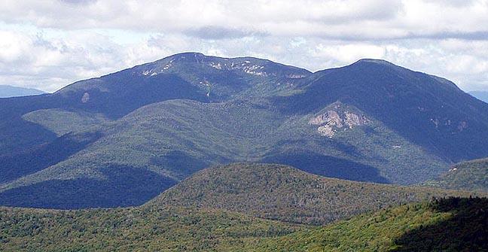
A Stay at the Black Bear Lodge
Stay in the stunning White Mountains of Waterville Valley, NH for
2 weekend nights (Friday –Sunday) OR 3 weekday nights (Monday – Thursday). *
The lodging features a fully equipped kitchen, living room, dining room, and bedrooms. Sleeps many (6+). At the base of the ski slopes, only 20 minutes from the brilliant climbing of Rumney or Cannon Cliff, access to beautiful hiking, shopping, and whatever adventure you may find!
Value: $500.00
Please contact Pete Clark for reservations at: (978) 877-0599 or e.peterclark@gmail.com
This is a private donation, not through Black Bear Lodge. *Reservations are for non-peak seasons*

Slide 2
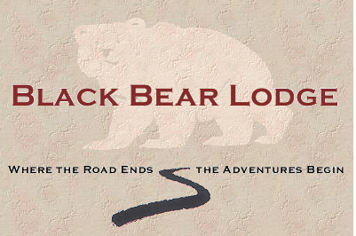

Slide 3
